Slide 1


MeshCentral

Slide 2

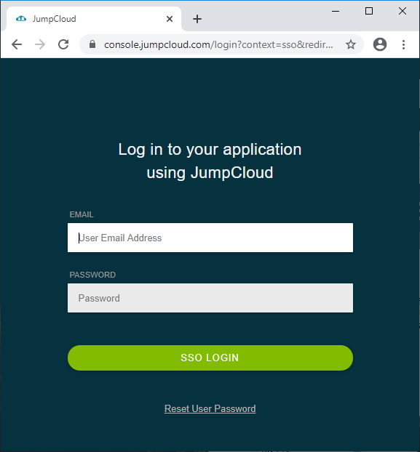
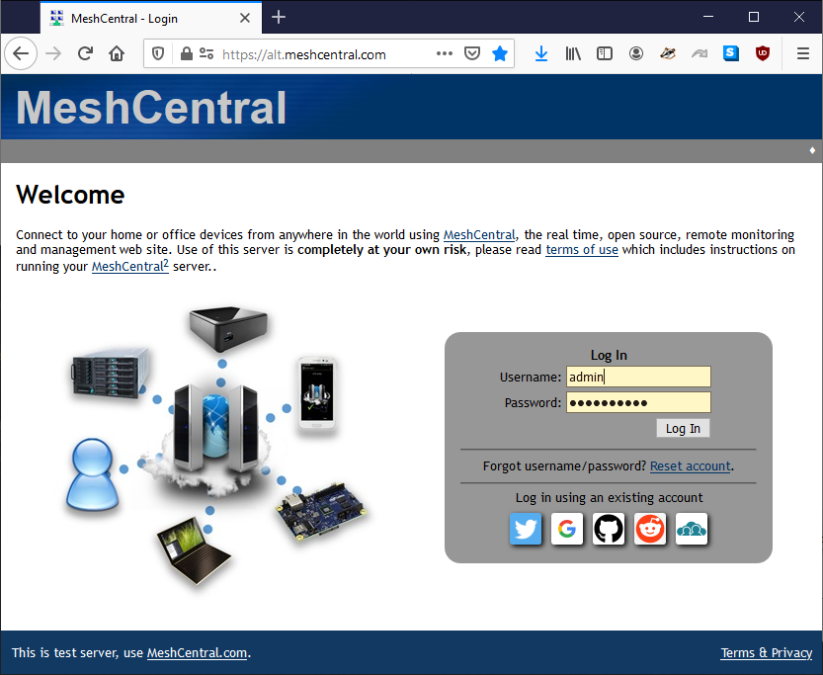
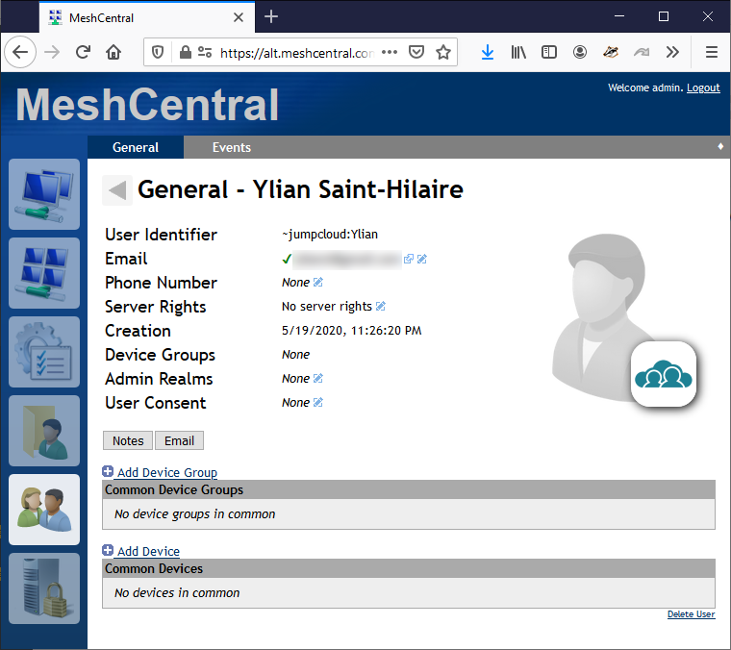
2
MeshCentral now has SAML single sign-on support and built-in support for JumpCloud, a well know single sign-on provider.
Users can now login to a single enterprise credential provider and have access to 100’s of web services including their own MeshCentral server.
1
3
SAML

Slide 3
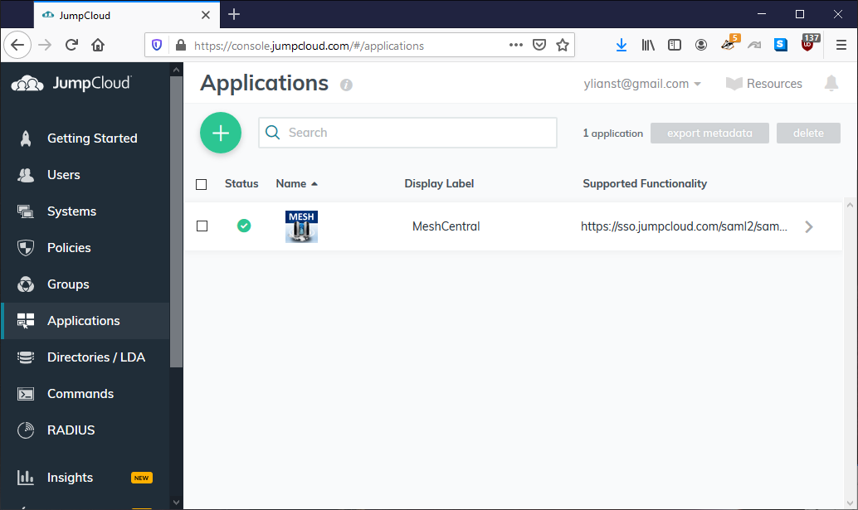

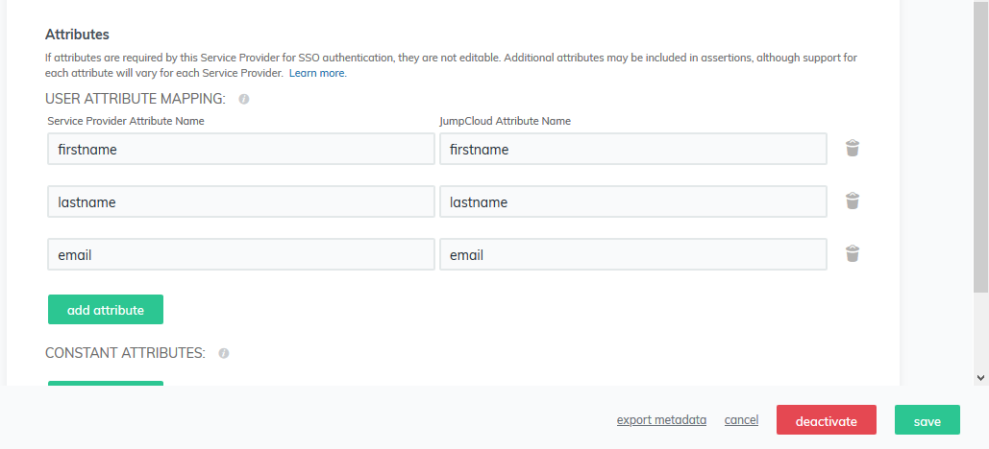
To get things setup, you need to create a new custom SAML application in JumpCloud and setup MeshCentral with the JumpCloud URL and certificate.
"authStrategies": {
“jumpcloud": {
"entityid": "meshcentral",
"idpurl": "https://sso.jumpcloud.com/saml2/saml2",
"cert": "jumpcloud-saml.pem“
}
}
The identity provider certificate will be used to validate assertions signed by JumpCloud.
Extra attributes can be configured in JumpCloud to allow MeshCentral to receive user name and email address.

